Slide 1
Diversity Committee Meeting:
Fall 2022 – Spring 2023 at a glance
August 31, 2022

Slide 2
Purpose of Diversity Committee
Purpose:
Charged with the goal of increasing diversity, equity, and inclusion in the college community by providing for the awareness, knowledge, and skills needed to successfully recruit and retain diverse students, faculty, and staff
Function:
Review data gathered by IR and/or other campus constituents on DEI-related topics and advocate for policy and procedural additions and/or revisions that promote a more diverse, equitable, and inclusive environment for all members of the college community.
Implement and assess, in coordination with key campus constituents, ILEA commitments.
Establish a process of documenting DEI efforts as a result of DEI task force recommendations, set benchmarks for success, report progress to campus constituencies, and, when necessary, make additional recommendations.
Provide educational and training opportunities for students, faculty, staff, and local community members to enhance the awareness, knowledge, and skills needed to be an inclusive member of the Blackburn community.
Assist in the recruitment and retention of underrepresented students who may need additional supportive services due to being a first generation college student, from a low-income neighborhood, from another country, from non-rural areas, and/or other dimensions of diversity including but not limited to race/ethnicity, sexual orientation, gender, religion, and disability.

Slide 3
Goals and Initiatives for
2022 - 2023
Create a diversity framework for the campus
Create a diverse hiring training for search committees
IDEAs challenge posting and awards
Cabinet - Strategic Goals review as they relate to DEI initiatives
Review of ILEA recommendations, data, etc.
MLK Leadership Award – update nomination form
Diversity Awards – Faculty and Staff
What Were You Wearing Exhibit and Speaker
Tunnel of Oppression
DEI Committee meetings Fall 2022

Slide 4
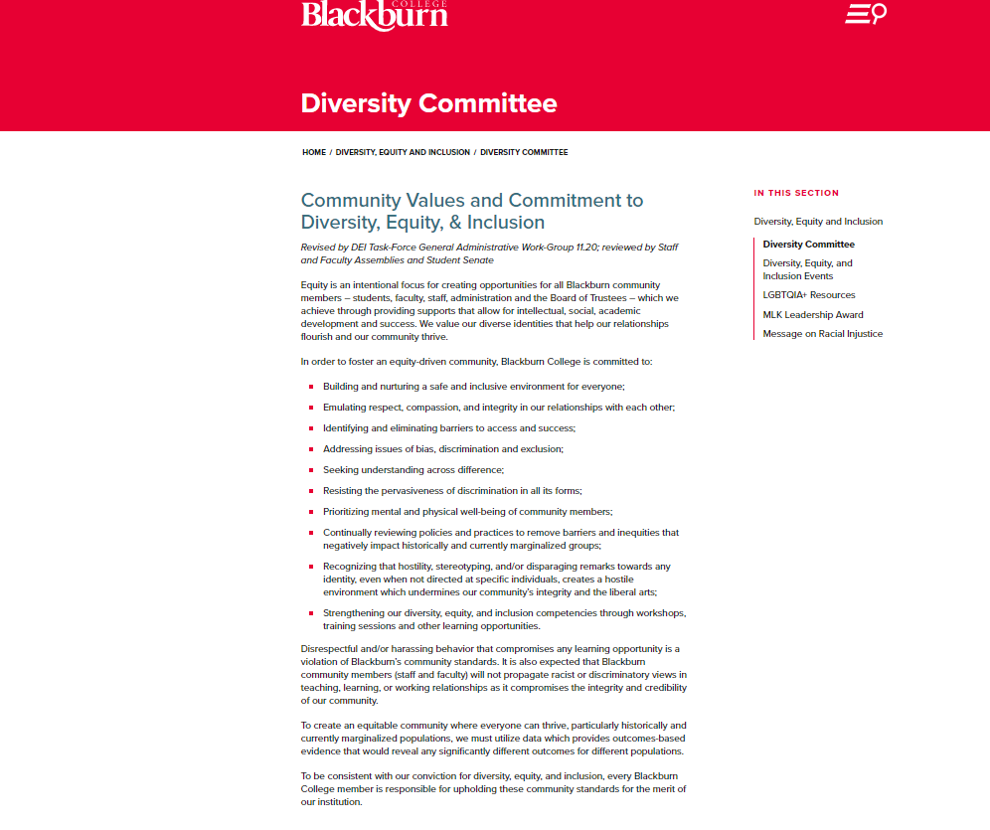
Website Updates:

Slide 5
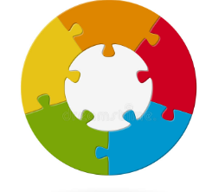
DEI Framework
*A plan for tracking and assessing progress on DEI Strategic Priorities
*Develop a framework that identifies the DEI goals and priorities for the college
*Metrics and Indicators
*Campus Climate surveys
*Organizational culture and accountability

Slide 6

Diverse Hiring in the Search Process
Presented by: Dr. Margaret A. Lawler

Slide 7
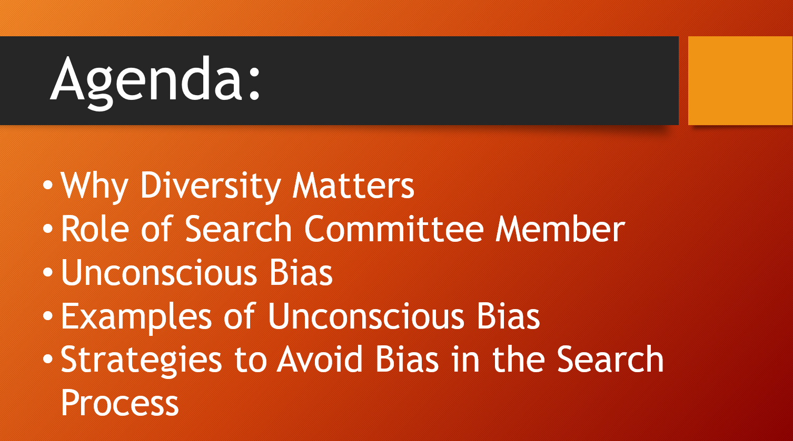

Slide 8
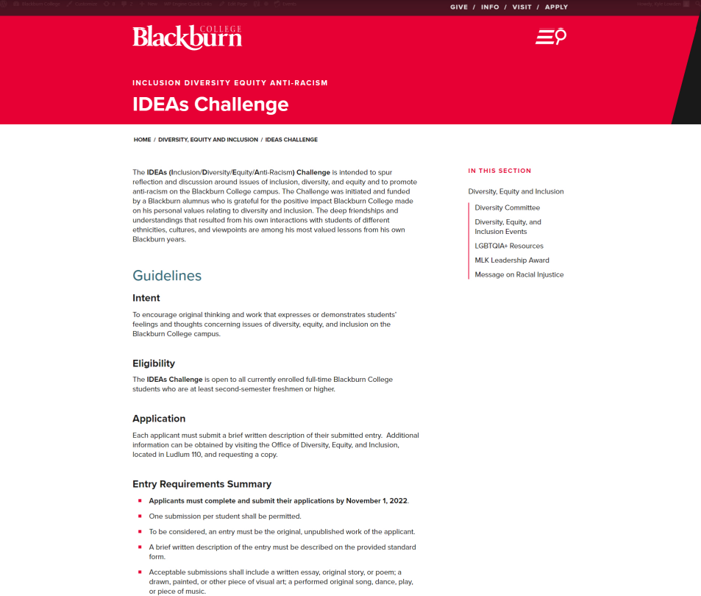
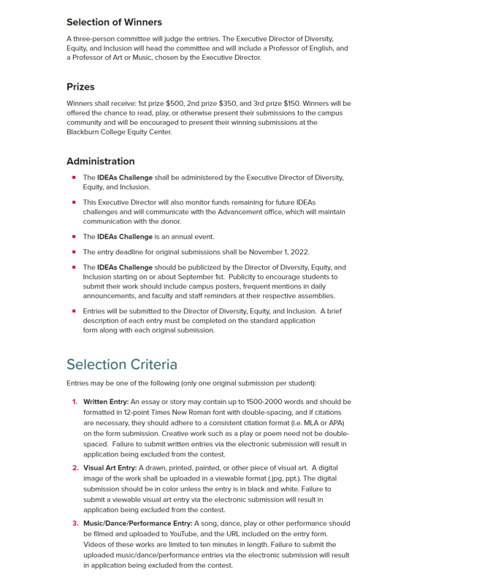
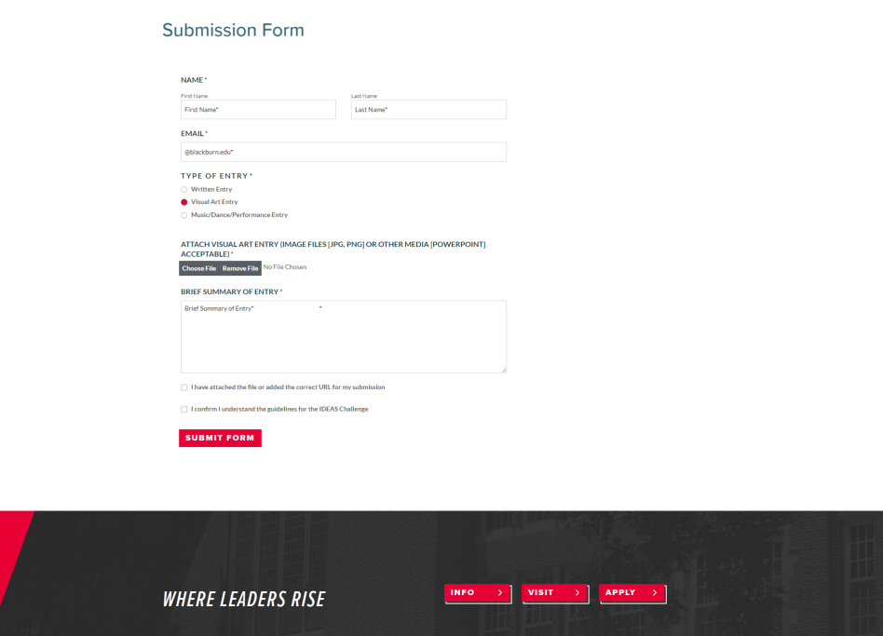

Slide 9
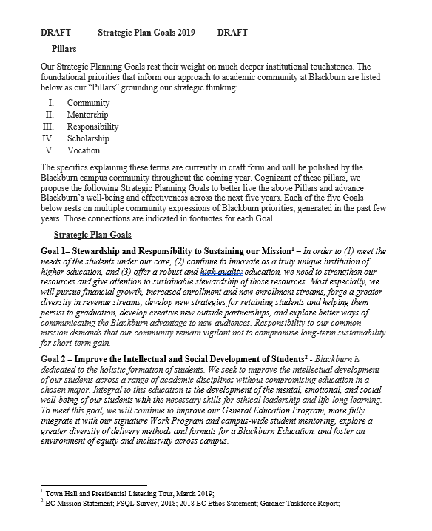
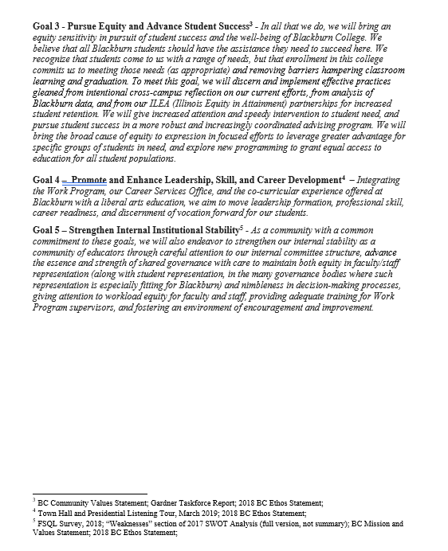

Slide 10
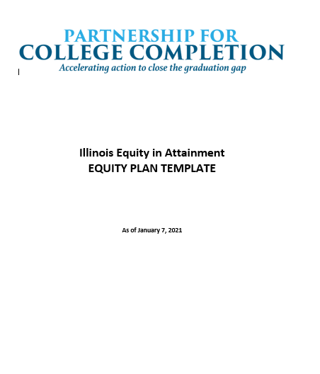
Review of ILEA Plan Recommendations

Slide 11
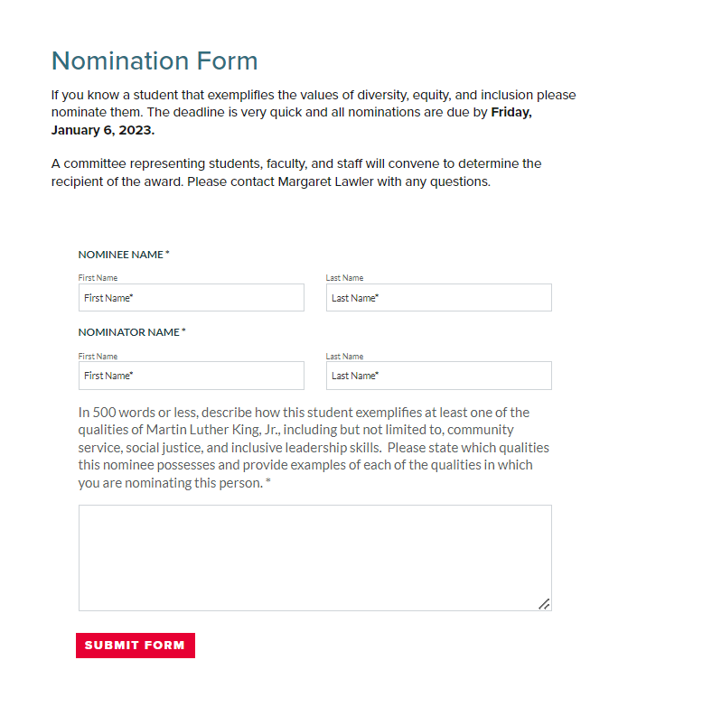
MLK Leadership Award Nomination form updates:
by November 30, 2022

Slide 12
Diversity Awards: Faculty and Staff
Staff and Faculty exemplify the principles of DEI initiatives:
*Uses the opportunities to build relationships
*Goes above and beyond
*Acts promptly and professionally
*Incorporates diverse values
*Creates an environment of access and commitment to diverse cultures, religions, and abilities
*Supports all individuals and their differences
*Mentors unrepresented students
*Each award winner will be given $250

Slide 13
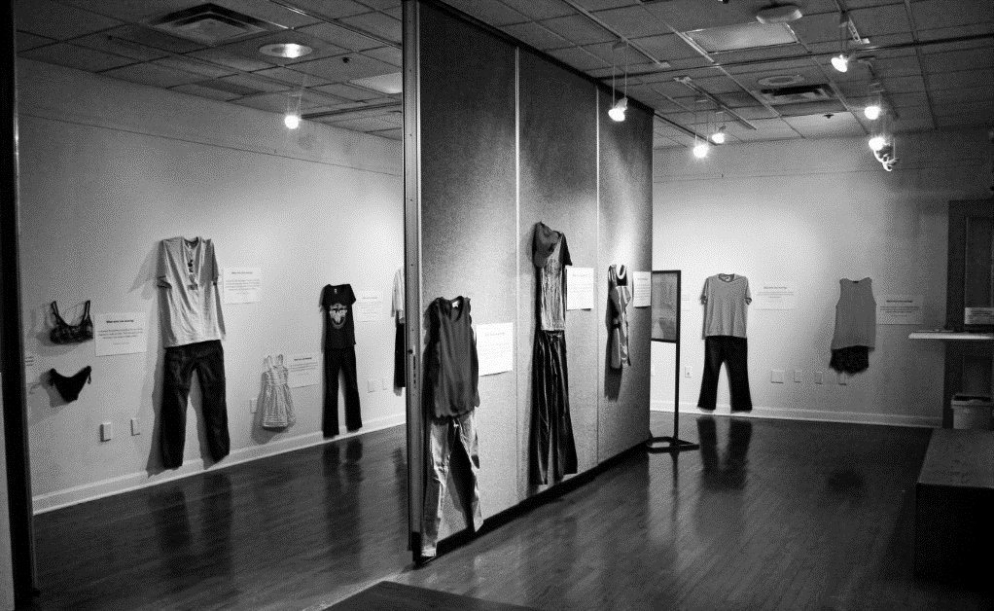
The Office of Diversity, Equity, and Inclusion would like to host an exhibit that displays and features stories of sexual violence and representation of what a victim was wearing at the time of their assault. The intent of the exhibit would be to remove the negative connotation of victim-blaming and debunk this myth that what an individual was wearing was “their fault”.
What Were You Wearing?
April 2023 is sexual assault awareness month. It will be the goal to display the exhibit in the Art department’s exhibit area that will highlight featured shared stories by survivors of sexual assault.
The exhibit will be displayed for three days in the Art exhibit area for participants to view in the month of April 2023. On the third day of the exhibit, a featured presenter will share their account of a sexual assault they experienced. The presenter will provide a shared account of their experience while highlighting “What they were wearing”, how they have overcome the assault through support and resources, and they will answer questions.

Slide 14
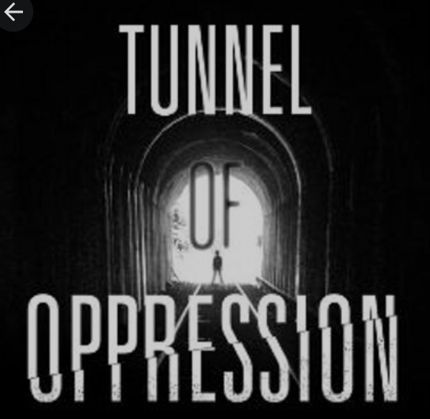
The Tunnel of Oppression is an interactive experience where participants walk through different "scenes" designed to display the many oppressions people are facing today. The Tunnel is a multisensory exhibition of some of the most difficult and complex issues we face today.
*will need campus and community resources

Slide 15
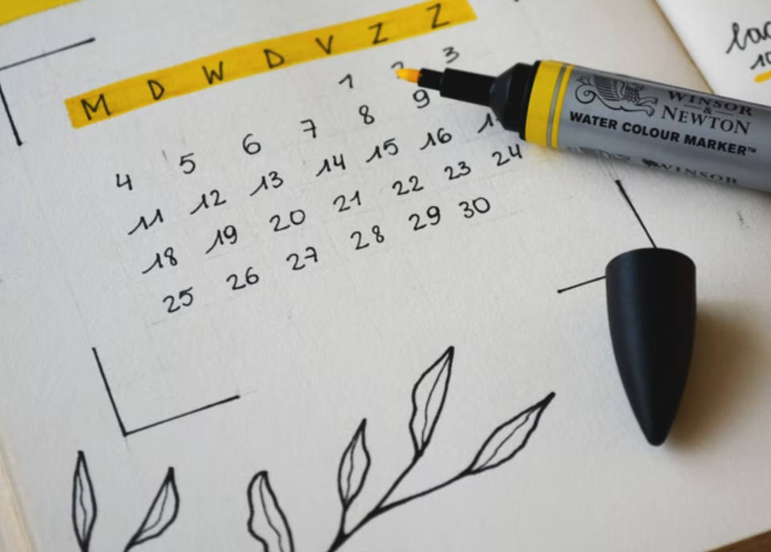
Meeting dates and times –
Fall 2022??

